Slide 1
A Brief History of Dying
Karen Smith, Ph.D.

Slide 2
Introduction
Welcome to the most fun you’ll ever have talking about death, dying & funerals.
Brief history of how dying has changed due to the advances in medical technology.
How to get the death you want ~ you need to start with the end in mind!
More than just talking about Advance Directives

Slide 3
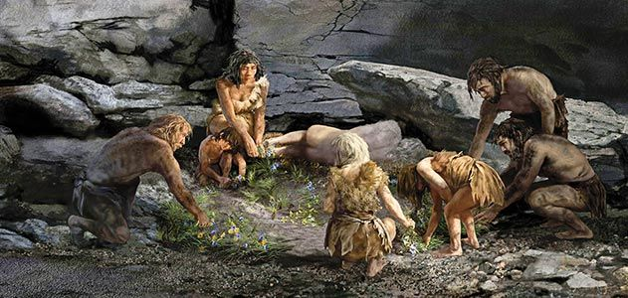
Neanderthal Burial Scene

Slide 4
The Story of Death …..

Slide 5
Philippe Aries :
“ The chasm between the discussion of death in books, which is still prolific, and actual death, which is shameful and not to be talked about, is one of the strange but significant signs of our times.”

Slide 6
Prior to the 14th Century

Slide 7
And you called them to gather….

Slide 8
A chance to get the lead ….
“Custom prescribed that death was to be marked by a ritual ceremony in which the priest would have his place, but only as one of many participants. The leading role went to the dying man himself. He presided over the affair, with hardly a misstep, for he knew how conduct himself, having previously witnessed so many similar scenes. He called to him, one-by-one his relatives and servants…..he said farewell to them, asked and gave forgiveness and blessings.”

Slide 9
Death as a public gathering….
People were born in public so they died in public.
“ When people in the street passed a priest with a viaticum , the y were obligated by custom and piety to follow him to the dying mans room even if he were a stranger.”
The approach of death transformed a dying mans room into sort of a public place. Pascal’s remark, “man will dies alone” can only be understood in the context of this crowed publicness, and in spite of it.

Slide 11
Ritual transfers and care for the dead
Franciscan monks often had a multi-step process for caring for their dead.
Buried in the soil that consumed their flesh
Later, moved them to expose them to air in a bell tower
This allowed desiccation, removed all smell and flesh.
Then finally placed in charnel.
Treatment time lasted up to a year.
Both bones and mummies were open to the public for visitors to view.

Slide 12
Catacombs of the Capuchin Convent, Palermo, Italy. Mummified Monks in charnel.

Slide 13
18th Century and before: Church floors paved with individual tombstones, structure raised upon the dead.

Slide 14
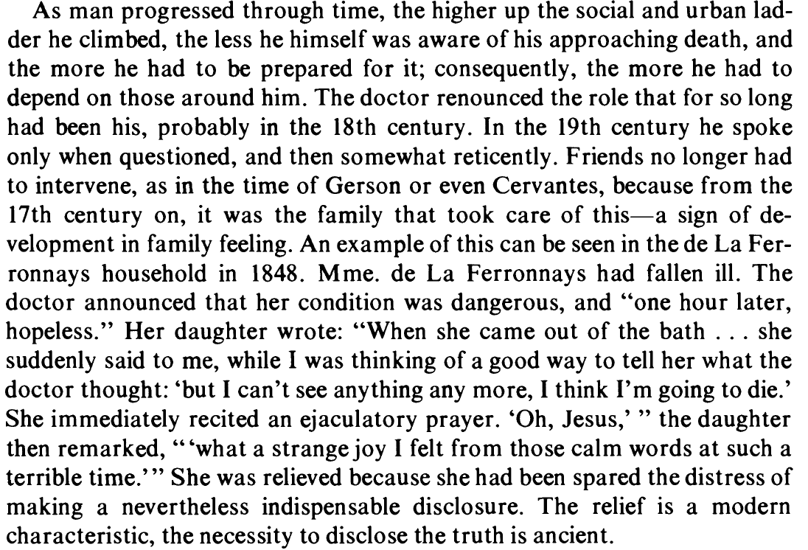

Slide 15
How Death has Changed….

Slide 16
80% of deaths occur in hospitals

Slide 17
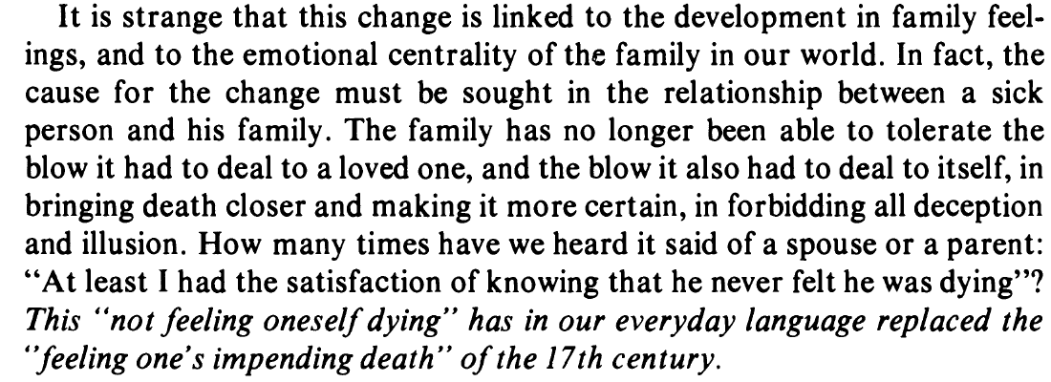

Slide 19
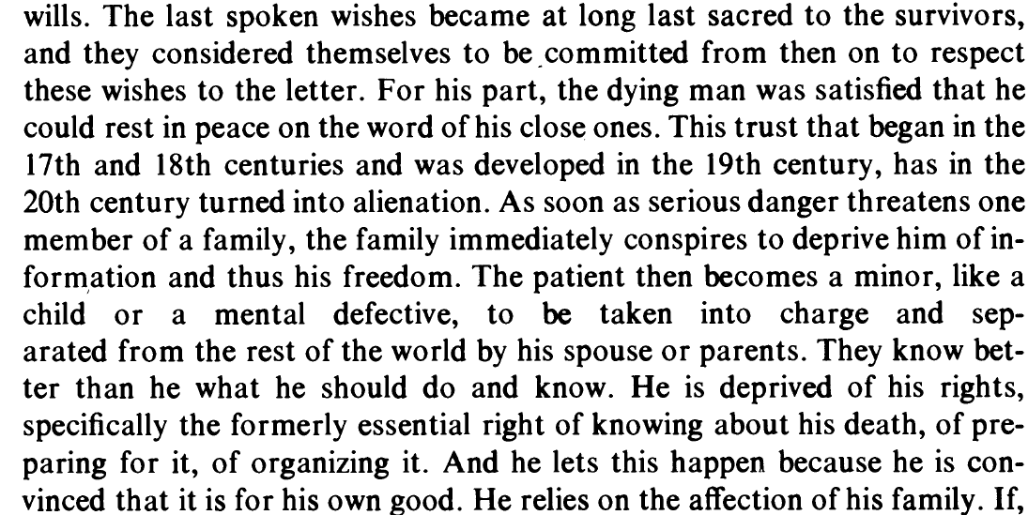

Slide 20
Death of Ivan Ilyich -- Tolstoy

Slide 21
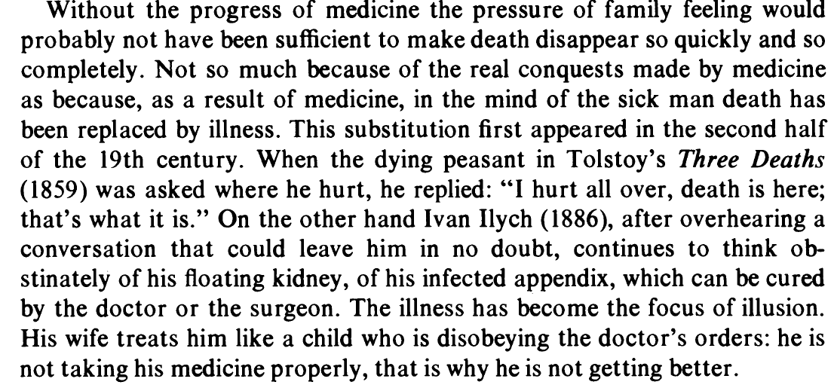

Slide 22
Now we must lead our doctors ….

Slide 24
Hospice often too little too late…..

Slide 25
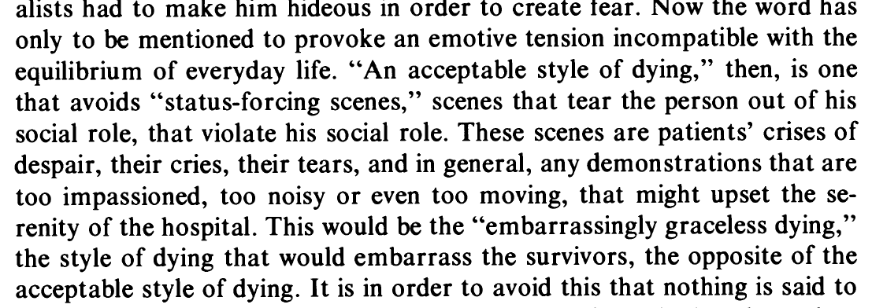

Slide 26
The tragedy of Death remains…..

Slide 27
Common Death Trajectories
A) Sudden Death
B) Cancer Death
C) Chronic Illness Death
D) Dementia Death

Slide 28
4 Common Death Trajectories

Slide 29
Death Trajectory …..
May affect obligations as you don't know which peak will be your last or which valley will be in fact your death.
Concerns over who to “really” listen to, the ‘current John’ who is demented but standing in front of you or the ‘former John’ who didn’t want anything done. Concept of precedent autonomy.

Slide 30
Ugly little truths…..
At the time of death 3/4 are non-ambulatory, 1/3 incontinent, 40% cognitively impaired.
Initiating End-of-Life Discussions with seriously Ill Patients- Timothy Quill,MD. JAMA nov. 15, 2000 Vol 284, No. 19 pg 2502-2507

Slide 31
“We all say, of course, that we would rather die surrounded by friends and family.
But behind this wish is usually another, more often unspoken , that we should die in a decent manner, preferably well-dressed, make-up unsmeared, face undistorted by pain or unbroken by violence, still pink and flushed and untainted by anything quite so offensive as blood. “
pg. 173Death and Philosophy
Edited by Jeff Malpas and Robert C. Solomon pub. Routledge, London and New York, 1998.

Slide 32
How to get the Death You Want!
Think, really think, about what it would be
Acknowledge which potential trajectory is likely
Make clear Advance Directives and SHARE THEM!!
Talk with your family about your wishes (in the end others are likely to be making decisions, so they are only wishes)
Realize that you will need to start accepting less care earlier than you think in order to get the death that you say you want.

Slide 33
Make DEMANDS on family & friends
Go ahead! They did it all the time in years past, let them know “How important it is to have them near”
Back to pre-K …… use your words…..they aren’t mind readers
OK, maybe send a letter or email but do it!
Have REAL conversations, share your fears, concerns, hopes. You will likely be pleasantly surprised that it will be easier than you think once you get started.
Ask for help, after all, we’re only human.

Slide 34
Contact Info:
Dr. Karen Smith
Cell: 865-951-8515
Ksmith67@hfhs.org
Follow me on FB at
Ethics Chick

